Slide 1
Network and Communication
Module 6 Congestion Avoidance
Dr. S. L.JAYALAKSHMI,
VIT Chennai

Slide 2
Session Outline
Congestion Avoidance Mechanisms
DEC bit
Random Early Detection (RED)
Source based Congestion Avoidance

Slide 3
DECbit
The routers and the end nodes are involved in this Congestion avoidance mechanism
Each router monitors the load and explicitly notifies the end nodes when congestion is about to occur
A binary congestion bit, DECbit, is set by the router to notify about the chance of congestion
The destination host in turn notifies the source by coping this congestion bit into the ACK
Finally, the Source host controls its sending rate in order to avoid Congestion

Slide 4
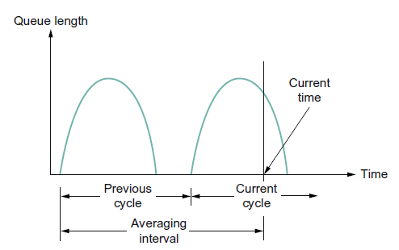
DECbit contd…
A router sets this bit in a packet if its average queue length is greater than or equal to 1 at the time the packet arrives
This average queue length is measured over a time interval that spans the last busy + idle cycle, plus the current busy cycle
The router calculates the area under the curve and divides this value by the time interval to compute the average queue length
A queue length of 1 seems to optimize the power function
Fig: Computing average queue length at a router.
*Source - Computer Networks: A Systems Approach, Larry L. Peterson and Bruce S. Davie, Fifth Edition, The Morgan Kaufmann Series, Elsevier, 2011

Slide 5
DECbit contd…
The source records how many of its packets has this congestion bit set
If less than 50% of the packets had the bit set, then the source increases its congestion window by one packet
Otherwise, the source decreases its congestion window to 0.875 times the previous value
The value 50% was chosen as the threshold based on analysis that showed it to correspond to the peak of the power curve.
The “increase by 1, decrease by 0.875” rule was selected because this AIMD makes the mechanism stable.

Slide 6
Random Early Detection(RED)
Unlike DECbit, RED implicitly notifies the source of congestion by dropping one of its packets
The source is, therefore, effectively notified by the subsequent timeout or duplicate ACK
The source then decreases the congestion window
Which packet to drop and when to drop?
Calculate and drop each arriving packet with some drop probability whenever the queue length exceeds some threshold . This idea is called early random drop

Slide 7
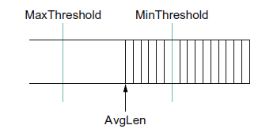
RED (contd…)
Step 1: Compute the average Queue length as follows:
AvgLen = (1−Weight)×AvgLen+Weight×SampleLen
where 0 < Weight < 1 and SampleLen is the length of the queue when a sample measurement is made
Step 2: if AvgLen <= MinThreshold
queue the packet
Step3: if MinThreshold < AvgLen < MaxThreshold
calculate probability P
drop the arriving packet with probability P
Step 4: if MaxThreshold <= AvgLen
drop the arriving packet
Fig: RED thresholds on a FIFO queue.
*Source - Computer Networks: A Systems Approach, Larry L. Peterson and Bruce S. Davie, Fifth Edition, The Morgan Kaufmann Series, Elsevier, 2011

Slide 8
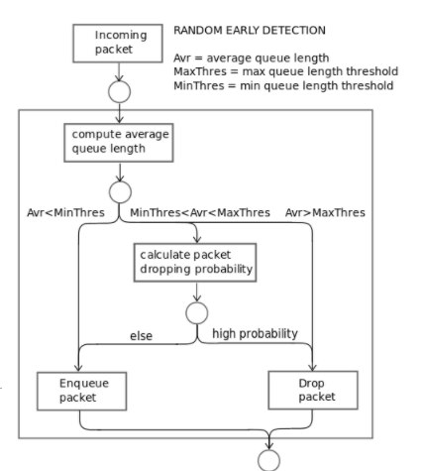

Slide 9
Source based Congestion Avoidance
Unlike DECbit and RED, it uses the end hosts (source)for avoidance mechanism
Source uses Round Trip Time (RTT) to notice the traffic on network
if current RTT > average of the minimum and maximum RTTs, then decreases the congestion window by one-eighth
Otherwise, increase the congestion window by 1.

Slide 10
References
Computer Networks: A Systems Approach, Larry L. P eterson and Bruce S. Davie, Fifth Edition, The Morgan Kaufmann Series, Elsevier, 2011.
Data Communication and Networking, Behrouz A. Fourozan, McGraw Hill Education, Fifth Edition, 2012

